Slide 1
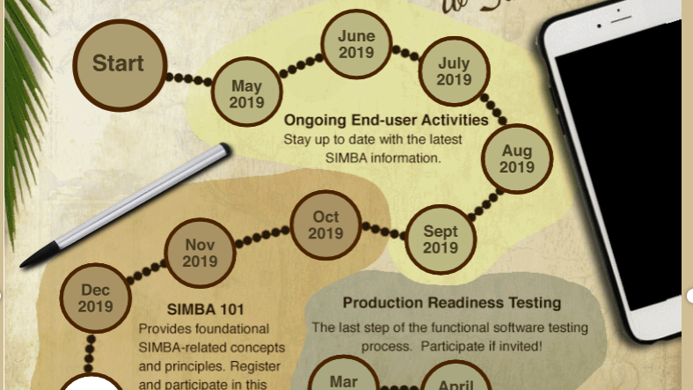

SIMBA
Let’s take the journey together
https://www.simba.psu.edu/map/

Slide 2

What Will Happen
Change will Happen
  Terminology is changing
  The Chart of Accounts is changing
  System access is changing
  How we do business is changing
Training will happen
Support will happen
This Photo by Unknown Author is licensed under CC BY-NC-ND

Slide 3
Terminology
IBIS Budget = SIMBA Cost Center (WorkDay is already using this term)
IBIS Object Code = SIMBA GL Code
SRFC = Non-PO Invoices
IDCC = Internal Service Request Form (ISR)
ROCR/RECR = Various: Cash Journal, Wire and ACH, Credit card Elavon, Third party systems.
Purchasing Requisition = Shopping cart
Purchase Order = Purchase Order
ICAG = Overview of AVC Data, All Postings
IBIS- Simba Terminology Crosswalk
  February 2020 IBIS-SIMBA Terminology Crosswalk

Slide 4

Terminology (Continued)
FICOFMGM (pronounced FICO FIM GYM) – What does this mean?!?
  These are the four ledgers in SIMBA
    FI = Financial - this ledger accounts for all financial transactions, except for budget, and is the primary ledger for tracking assets, liabilities and net assets. This ledger is used for financial statements and is the ledger that adjusts for accrual accounting, including management of payables and receivables.
    CO = Controlling - this ledger is used for cost allocations. It will not be used extensively at go-live and will be used primarily by the Corporate Controller's Office.
    FM = Funds Management - this ledger is focused on the budget and accounts for all transactions which impact budget, revenue or expense. This is the primary ledger that departments at Penn State will use to manage general fund operations. Reports from this ledger will show budget, encumbrance, actual and balances, like the current ICAG/ISTR reports in IBIS.
    GM = Grants Management (GM) - this ledger accounts for all transactions which post to Grants. It accounts for all elements - assets, liabilities, net assets, revenue and expense, as well as budget. This allows for total reporting on grant activities for sponsors and others, including balance sheets and income statements.
This is where we will live.

Slide 5
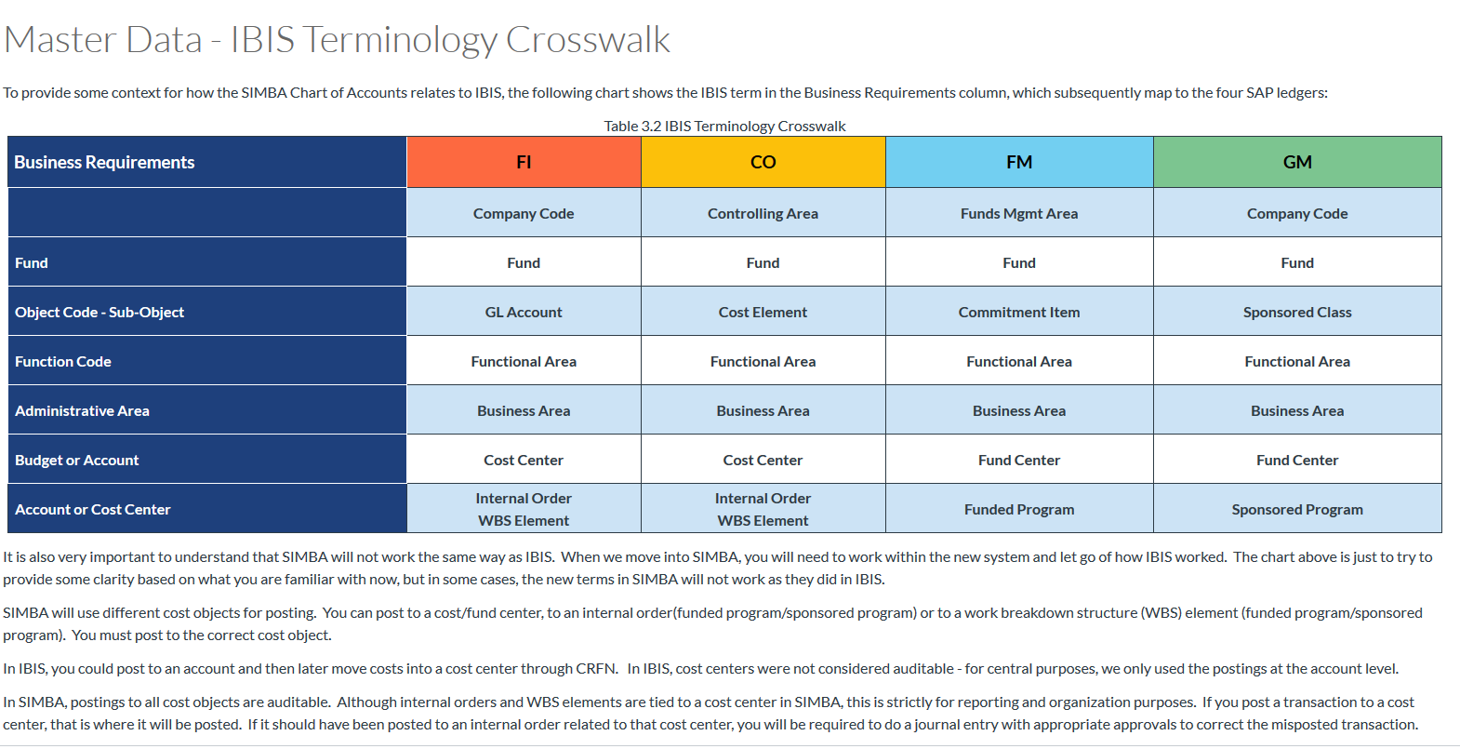

Slide 6
Chart of Accounts
Account Hierarchy
Business Area: 2730
Penn State York
Department 01
Chancellor
Department 02
Finance
Department 03
Business Services
Cost Center/Fund Center
2730100000
Cost Center/Fund Center
2730200000
Cost Center/Fund Center
2730300000
XXX
XX
XXXXX
1st 3 digit of Business Area
Department
Sequentially Numbered

Slide 7
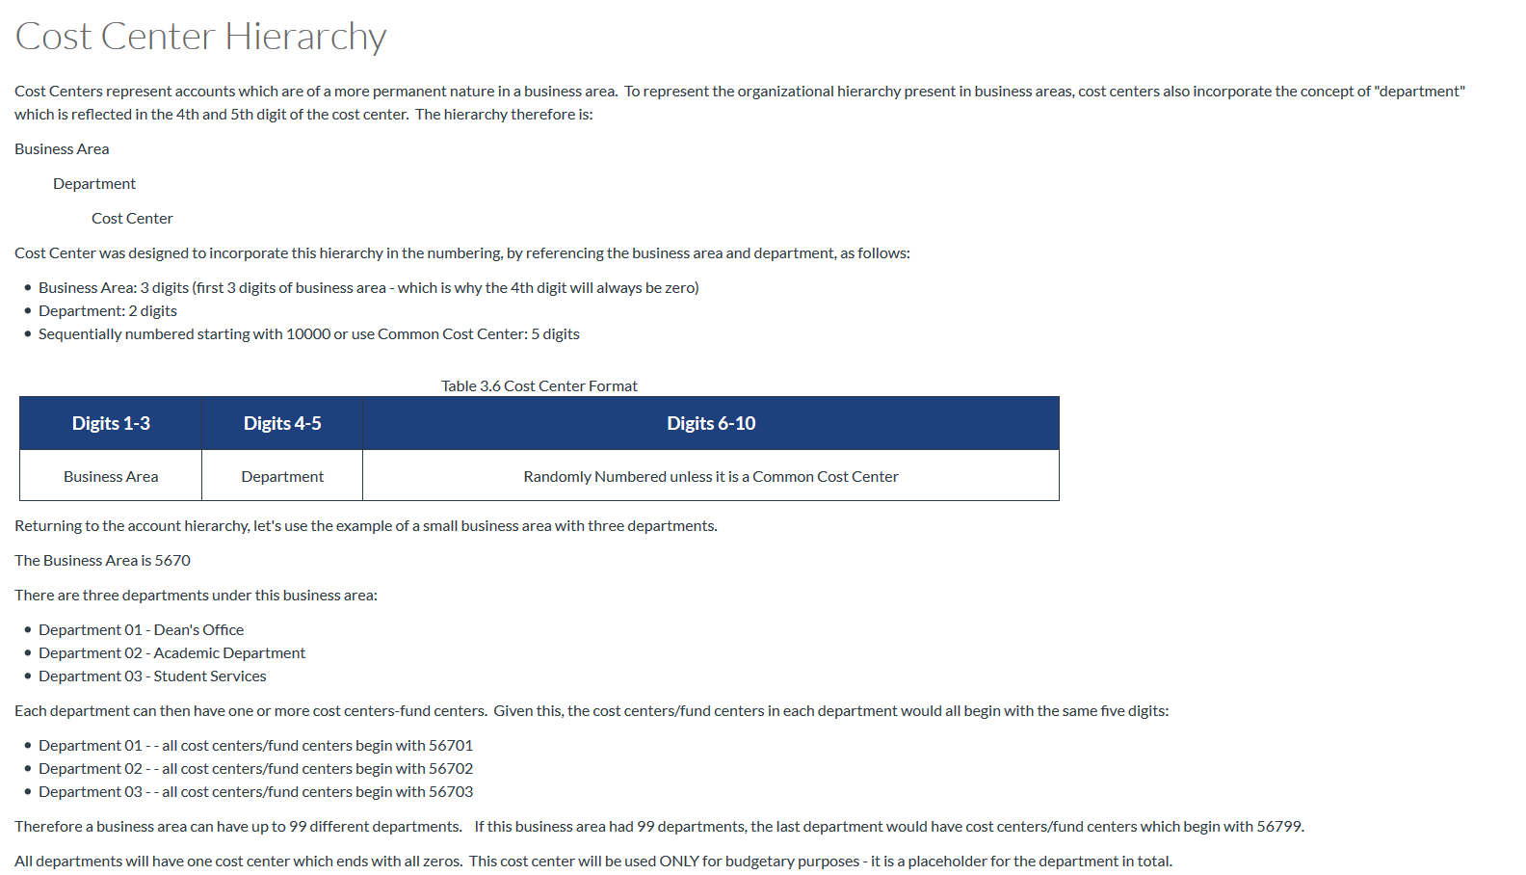

Slide 8
Chart of Accounts
Account Hierarchy
Business Area: 2730
Penn State York
Department 01
Chancellor
Department 02
Finance
Department 03
Business Services
Cost Center/Fund Center
2730100000
Cost Center/Fund Center
2730200000
Cost Center/Fund Center
2730300000
Internal Order
Funded Program (FM)
Sponsored Program (GM)
Begins with 10-89
WBS – Work Breakdown Structure
Funded Program (FM)
Sponsored Program (GM)
Begins with 95-99 (not commonly used at the campus level)

Slide 9
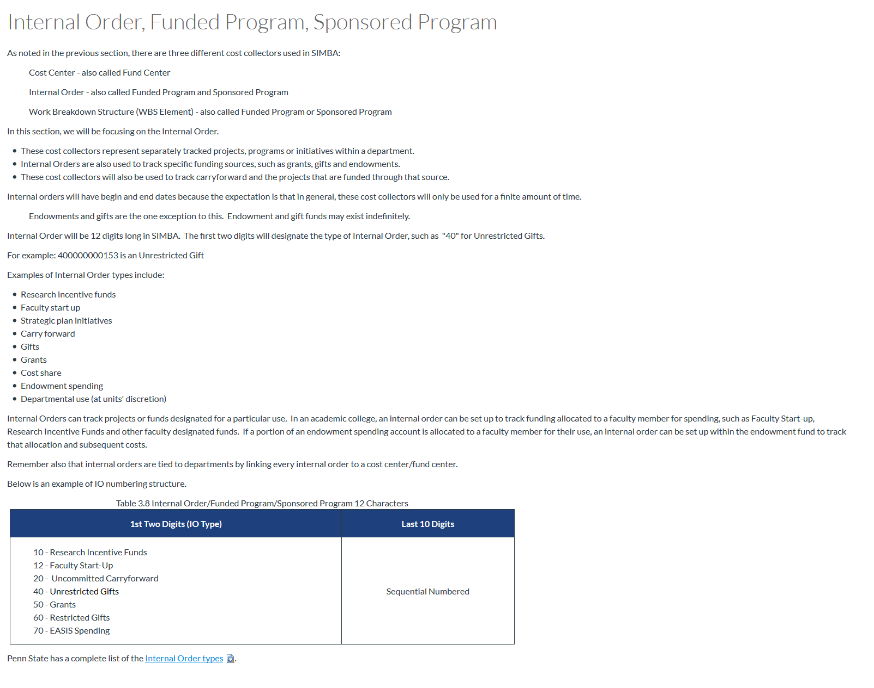

Slide 10

What do we know about our chart of accounts?
York has a total of 40 departments
Most IBIS budgets will have a cost center in SIMBA
Expense will be tracked differently than in IBIS example: SIMBA Cost Centers will not have “office supplies” as an internal order to track that expense type. Reporting will allow you to pull the information based on the GL account.
We will all be learning together

Slide 11

York’s Chart of Account

Slide 12

System Access is Changing
SIMBA’s security model is role based
    Transactional Roles “ What you can do.”
    Data Roles “What you can see.”
    Standardized roles will be established grouping functionality to give necessary tools for an individual to perform your job duties
    Role assigning at the campus level is being reviewed
    January 2020 SIMBA Newsletter
This Photo by Unknown Author is licensed under CC BY-NC

Slide 13
How we do Business is changing
Systems are going away, say good-bye to IBIS and eBuy
Concur (commonly referred to as ERS) will be expanding to include all p-cards
Cost centers (now internal orders) will be used on a limited basis to track expense
Reporting capabilities will be enhanced
Many more changes to come

Slide 14

New Process for Good and Services Purchasing Card (PCARD) Transactions
ALL purchasing card transactions, including Goods and Services will now be managed in SAP Concur, not just travel.
Goods and services PCARD transactions will flow into Concur and will be settled in a goods and services report. This report may be completed by the cardholder or by a delegate.
A delegate can submit the report on behalf of an employee. The delegate must print the Submit form Certification, and the employee must sign the form which is then attached to the report.
Given this required review, monthly statements will no longer be issued and will not need to be signed and retained as is now required for control purposes.
Reports can settle one or more PCARD transactions for the same employee (report is unique for the cardholder)

Slide 15
New Process for Good and Services Purchasing Card (PCARD) Transactions (continued)
Receipts and back-up material supporting the transactions being settled can be scanned into Concur, as is now done for travel
    Purchasing Card Support Forms will no longer be required.
    Once scanned or uploaded, paper receipts do not need to be maintained.
Unsupported transactions which were mistakenly put on the PCARD can be settled with deductions made through the payroll system, as is now done with travel.
Reports may also include cash reimbursements for non-travel expenses. Payment to the employee would be to the designated bank account, just as is now done for travel.

Slide 16

Prepare for the Journey
SIMBA Three-step Training Approach
Tell Me
  Core of basic instruction
  Delivery of facts, rules, processes, and basic knowledge
Show Me
  Learner sees the tool in action
  Includes live demos to simple animations
Let Me
  Learner is hands on with the tool
  Uses scenarios to let learners see results as a product of their actions
This Photo by Unknown Author is licensed under CC BY-SA-NC

Slide 17

Instructor-Led Training (ILT)
  Hands-on, face-to-face training
  Learner will engage with software
  Regional training opportunities
Virtual Instructor-Led Training (vILT)
  Virtual environment such as a Zoom session, learner in separate environment
  Environment may or may not be hands on
Web-Based Training (WBT)
  Self-directed, self-paced training that is anywhere, any-time instruction delivered over the Internet to learners. Options could include:
    Micro-learning such as instructional videos or quick tutorials
    Whole Course Delivery such as click-through demonstrations. For example: SIMBA 101
Training Delivery Formats

Slide 18
Training Timeline
Activity | Dates
SIMBA 101 (self-paced) / Foundation Building | Fall 2019
Training Schedule Communicated/Registration Begins | Early Spring 2020
Web-based (self-paced) Prerequisite Training | April 2020
End-user Instructor-led training | May – June 2020
Go-Live! | July 2020

Slide 19

Prepare Now
You should have already started
Website
  Loads of information including team member information, FAQs, training, previous newsletters and SIMBA sessions
Monthly Newsletters
  Contains project updates, monthly focus, change management corner, and more
Monthly SIMBA Sessions
  Continuing series of live webinars with project updates, spotlight discussion and live Q & A
SIMBA 101 (register on the website)
  Self-paced, online course providing a solid foundation focusing on core SIMBA financial concepts
This Photo by Unknown Author is licensed under CC BY-NC-ND

Slide 20

Post-Production Support
Three-S Approach
Situation: you have a question in the moment while performing a transaction
Seek: use one of the recommended methods to seek answer
Solution: you find the answer and are able to complete the transaction
Support Formats (not exhaustive)
Simulations : Short demos end user views a task from start to finish
Hands-on Guide : Scripted walk through simulations
Reference Guides: Performance support materials that are not transaction based
Web-based Training: Self-directed, self-paced

Slide 21




SUPPORT PHASE
SCAR
System
Confusion
Anxiety &
Rage
This Photo by Unknown Author is licensed under CC BY

Slide 22

Let’s take the leap together!!!
Simba
IBIS

Slide 23

QUESTIONS

